Slide 1




Shifting our sales mix toward more online
retailer accounts will drive greater sales
growth

Slide 2
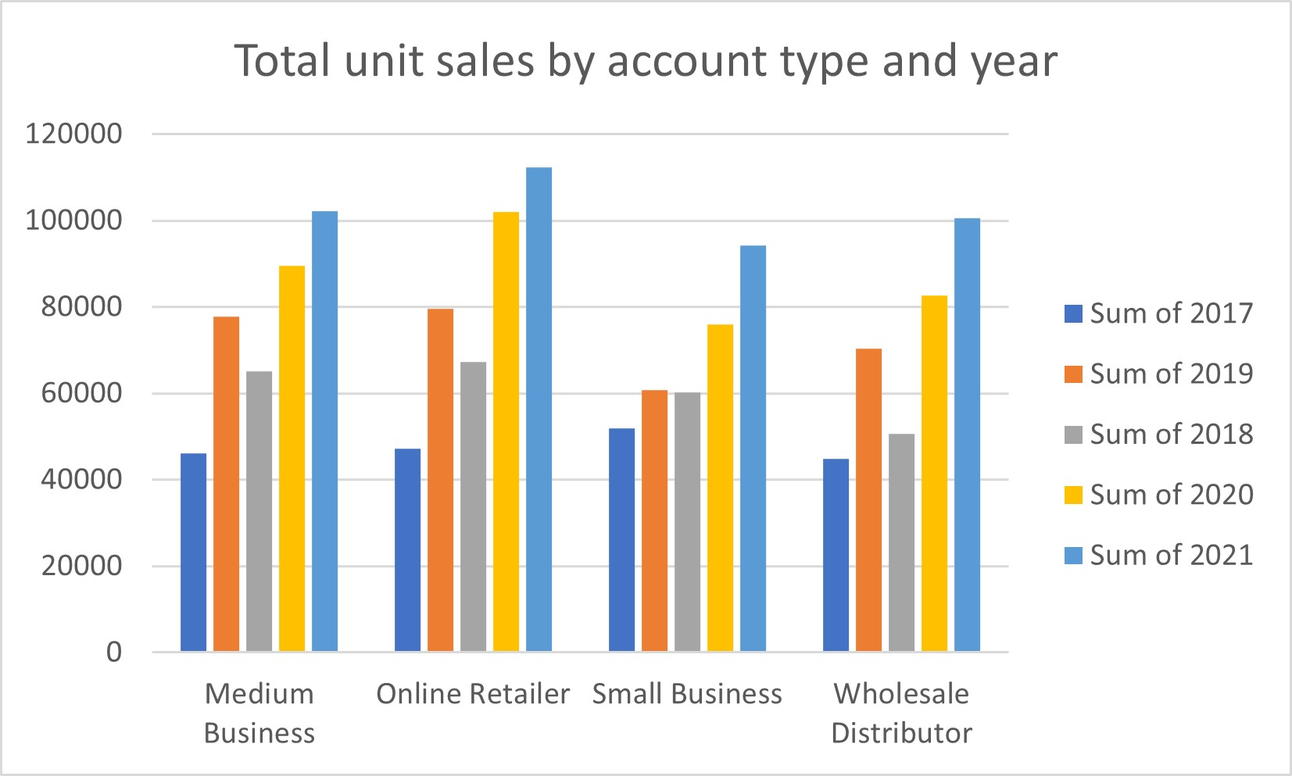
Among all type of accounts, the Online Retailer has highest sales in 2021.
While comparing the sales, it is observed that Small Business has lesser number of sales in every year except 2017.

Slide 3
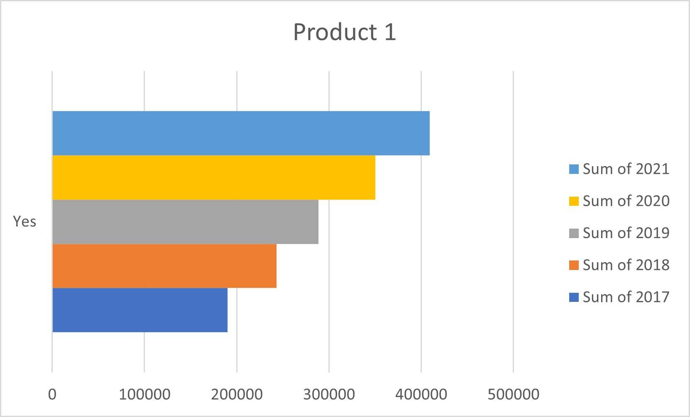
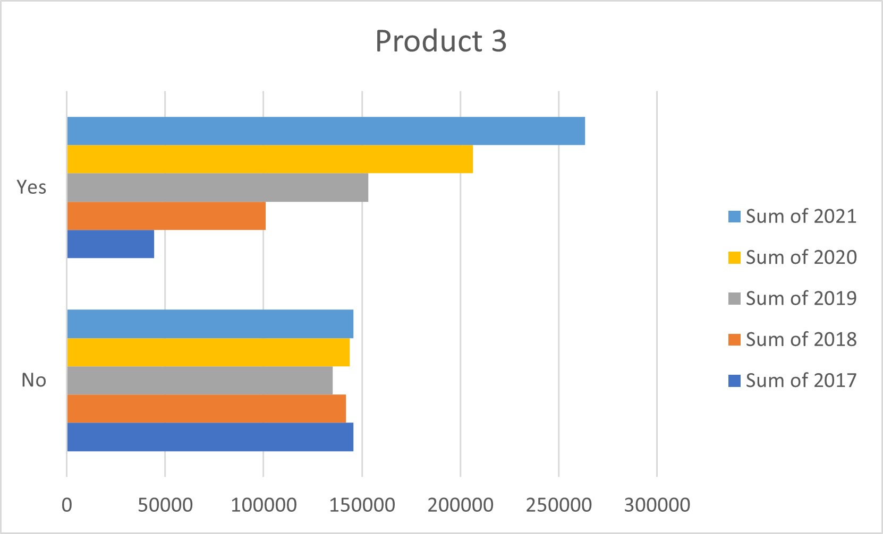
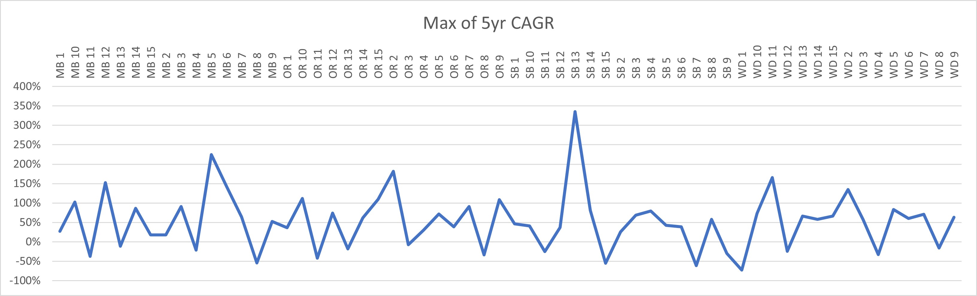

Slide 4
Summary
The online Retailer has the highest sales among all the different account types each year, so it's better if there are more Online Retailers.
On the other side, Small business has a smaller number of sales when compared to others, so we need to think of new ways to increase sales for Small business.
Every Decision maker is saying yes to Product 1. We can make this a signature product.
Many of the Decision makers are not considering Product 3, so we should improve Product 3 or introduce a new product.
We recommend to close underperforming accounts immediately and launching an effort to identify the highest potential online retailer accounts for increased sales and marketing investment.

